Slide 1
Family & Community
Engagement
Advisory
Council
FEAC
EVERETT PUBLIC SCHOOLS
October 3, 2023
WELCOME

Slide 2
Land Acknowledgement
We respectfully acknowledge that we are on the traditional lands of the Coast Salish, Snohomish and Tulalip Peoples, as we begin to heal. Everett Public Schools is committed to improving the relationship and identifying indigenous people, exploring our true selves. We express our deepest respect and gratitude to the ancestors of this land. We strive to create equitable outcomes and build a culture of inclusive belonging for all students, teachers, staff and community.
Land Acknowledgement
Notes:
Anne

Slide 3
Agenda
6:00 – 6:10 Welcome and Opening Comments
Chris Fulford
Dr. Saltzman
6:10 – 6:20 Time to reconnect.
Chris Fulford
6:20 – 6:40 Approve FEAC Vision and Mission statement.
Chris Fulford
6:40 – 7:20 School Website Look Fors and Feedback Activity
Joi Grant
7:20 – 7:30 Closing
Chris Fulford
Agenda

Slide 4
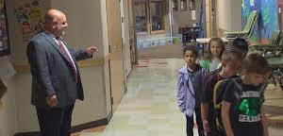
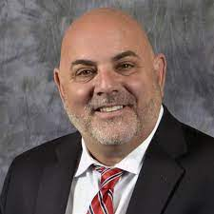
Welcome
Dr. Saltzman
Welcome
WE

Slide 5
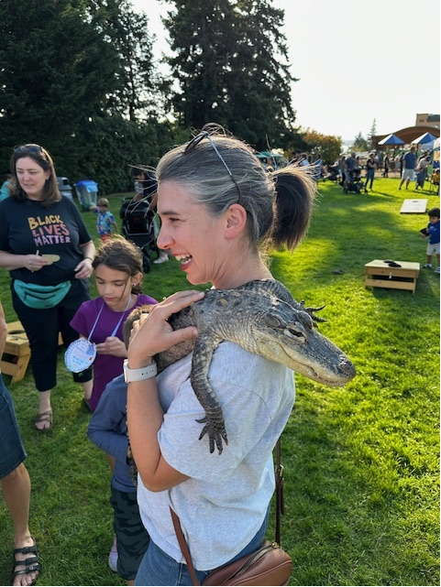
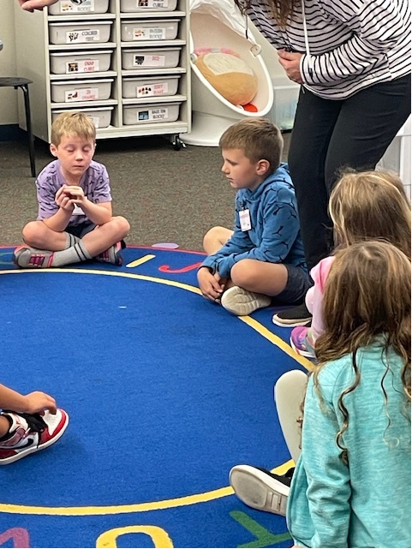
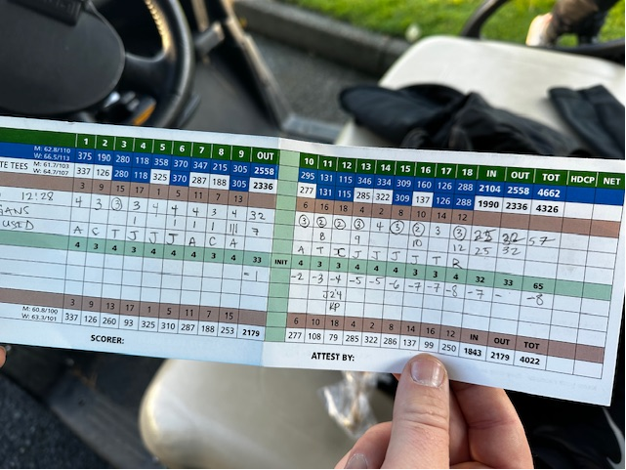
Photo opportunity
Bring your phone with you.
Find a partner you do not know or have not connected with in a long time.
Open your photos and share your most recent photo and the story behind it.

Slide 6
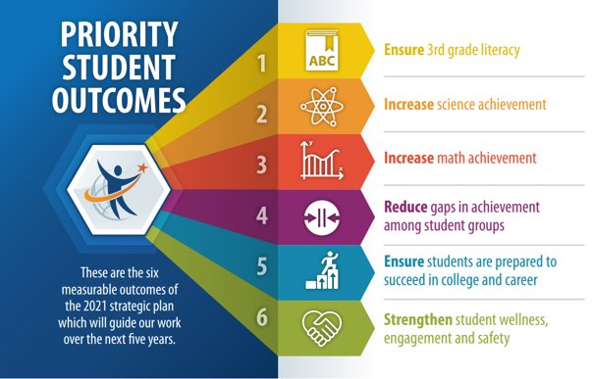
Priority Student Outcomes
Notes:
Chris

Slide 7
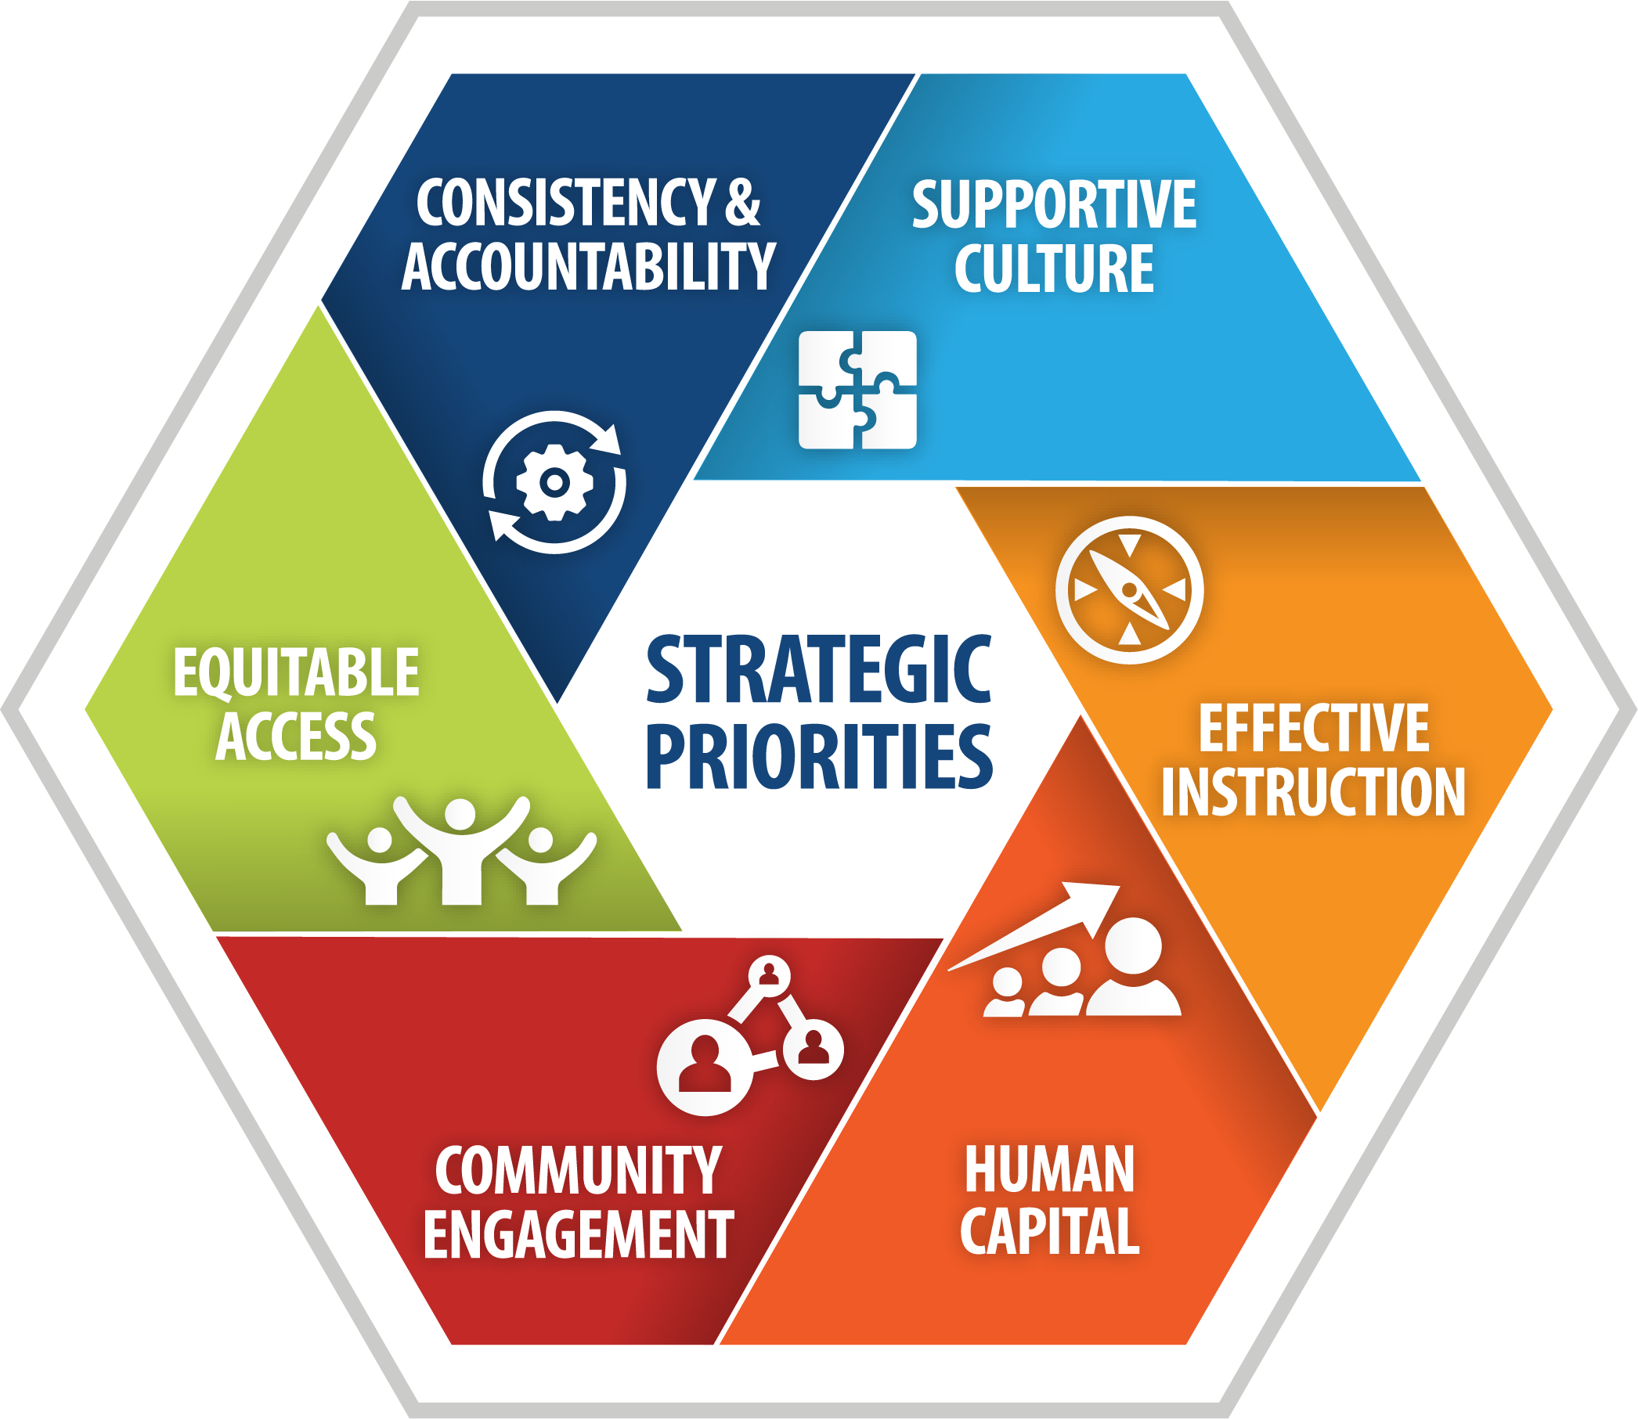
Priority Student Outcomes
Notes:
Chris

Slide 8
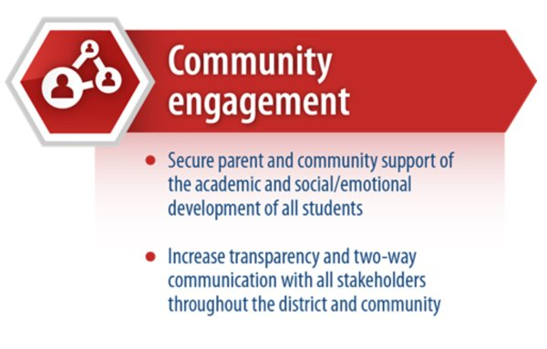
Strategic Theme
Notes:
Jeanne

Slide 9
Norms of Collaboration
Stay engaged​
Expect to experience discomfort at some level​
Paying attention to self and others​
Be aware of intent: Own your impact​
Keep focused on our collective goal​
Speak your truth​
Maintain a learner stance and remain open to new thinking​
Pursuing a balance between advocacy and inquiry

Slide 10
Approval of FEAC Mission and Vision Statements
Family Engagement Advisory Council
(FEAC)
When defining families, we are including not just traditional families, but inclusive of every unit in society that fulfills the roll of family.
Vision
Families, communities, and schools work as partners to ensure each student is prepared for and thrive on their chosen path.
Mission
Families working directly with district staff and school leadership, bringing the family voice to district and school-level decision-making.
Families and schools working together to provide a safe environment for families to engage with district staff. Working together to produce students who are prepared to thrive on their chosen path.
Collective Ownership

Slide 11
2023 -2024
School Year
Feedback
School Website Look Fors & Feedback Activity

Slide 12
WEBSITE COMMUNICATION
USER: training5
PASSWORD: password
Website Communication

Slide 13
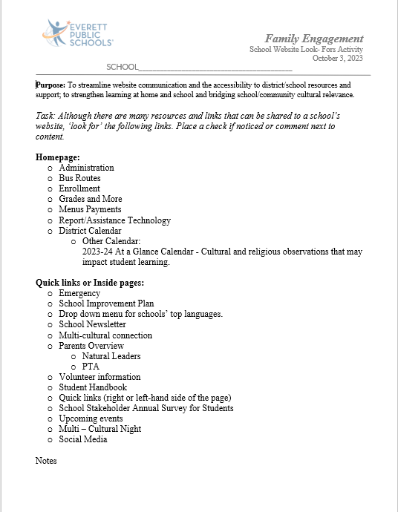
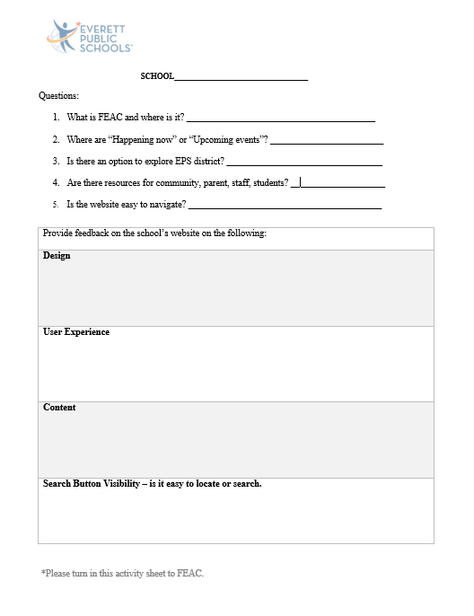
WEBSITE COMMUNICATION
Website Communication

Slide 14
Thank You!

